Slide 1
Case Study​
Marino College
​
School Coordinator:​
Joan Lyne
​
Creative Associate​
Heather Gray

Slide 3
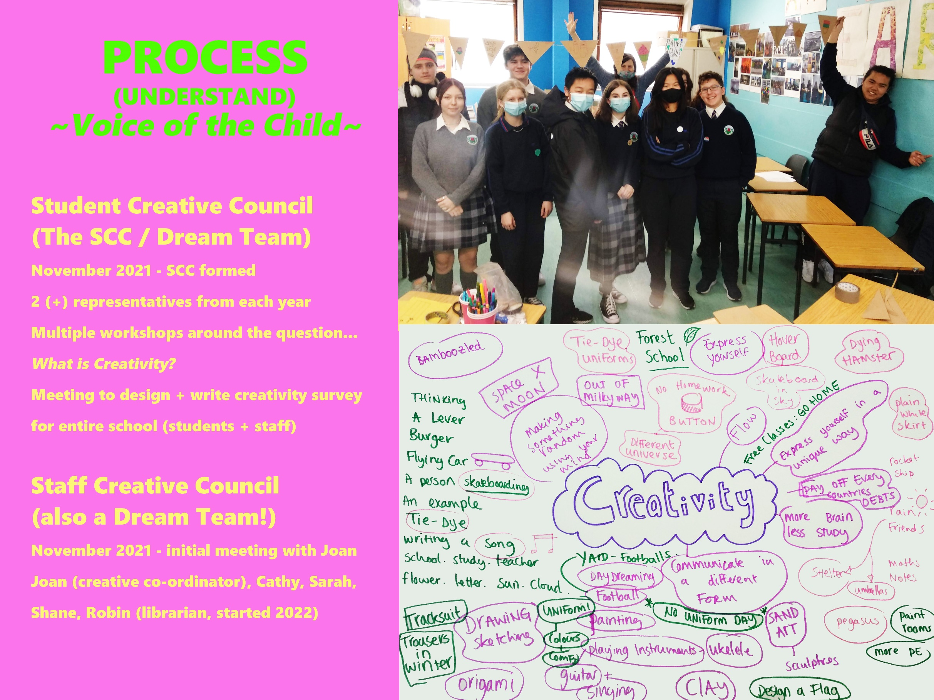

Slide 6
